Slide 1
Comparing the adaptation index stability with or without trial filtering
Left side: with trial filter
Right side: “without” trial filter:
Contains all bad trials based on pupil and speed data
Subsample the good trials so that `bad + subsampled good` = total number of good trials

Slide 2
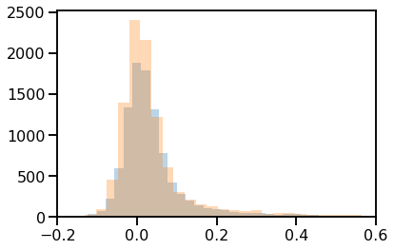
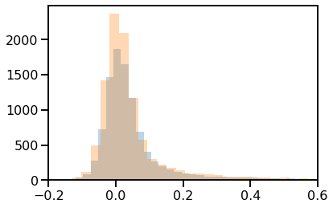
Distribution of R1 (blue) and R2 (orange)

Slide 3
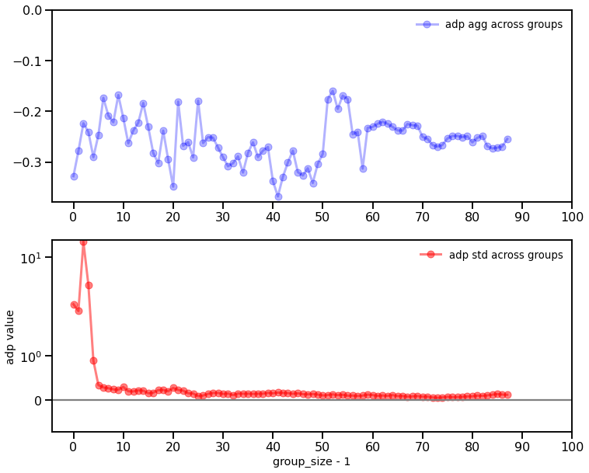
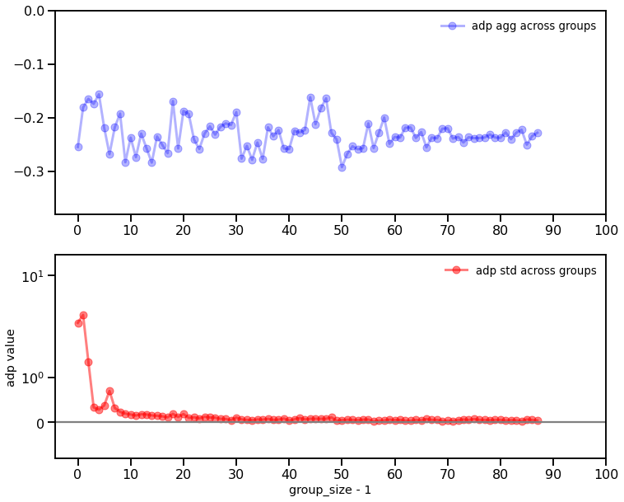
Population adaptation stability

Slide 4
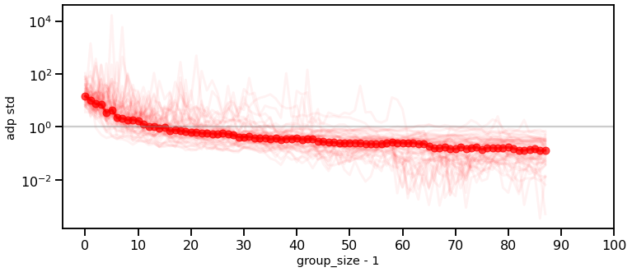
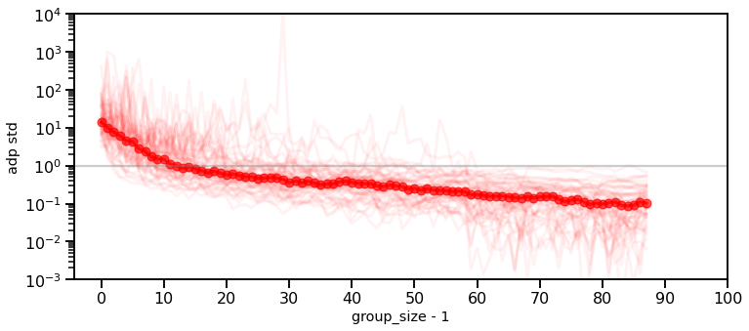
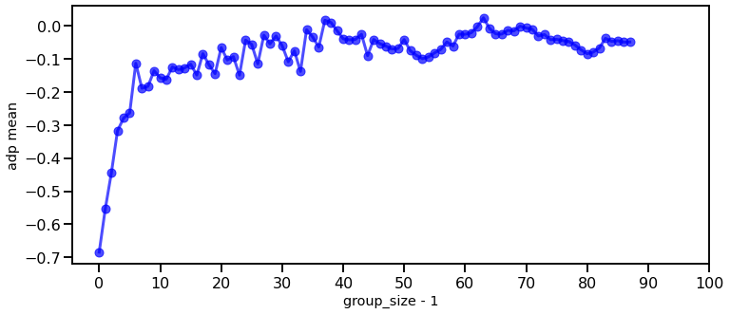
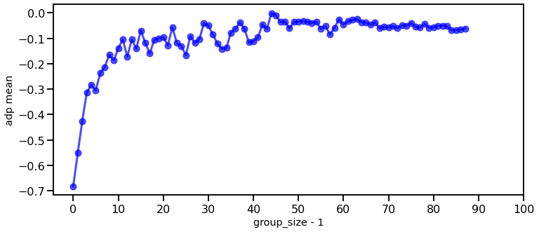
Single cell adaptation stability

Slide 5
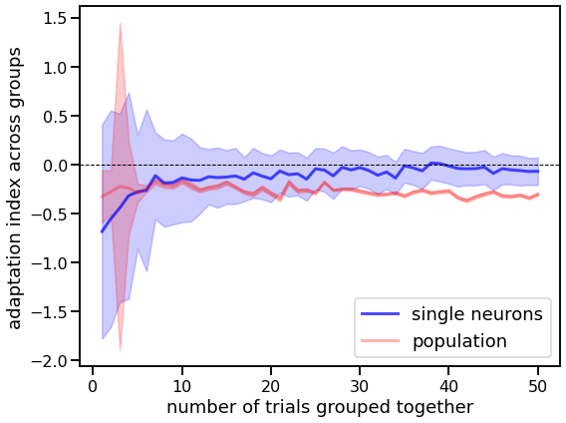
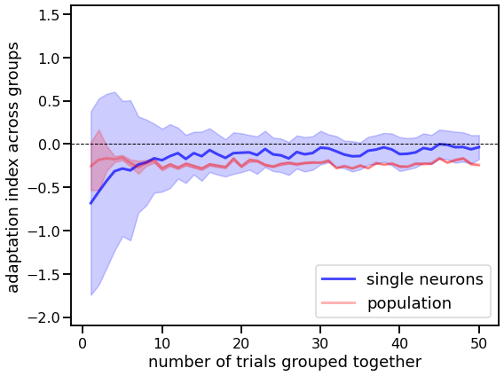
Summary plot

